Slide 1

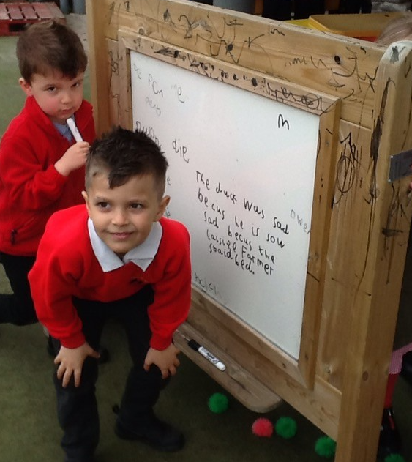
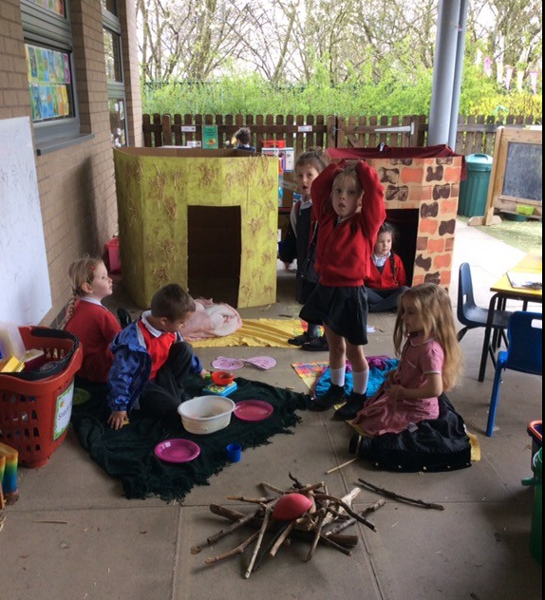

Welcome to the Merton Primary Foundation Stage
Parent Induction Meeting
22nd June 2021

Slide 2
Welcome to our School
Our Mission:
‘To be the best we can be’ by…
Encouraging children to make a difference to their own lives and the lives of others, close by and in the wider world
Supporting personal achievement through an inspiring curriculum that enables success for all and high expectations, driven by purposeful, relevant, practical lessons that children can fully invest in
Maximising the potential of each individual’s character, supporting growth through real-world examples both within and beyond the school to ensure children can succeed and flourish in a changing world
Prioritising physical and mental health, creating a culture of nurture and happiness where children have the capacity to thrive emotionally, socially and academically
Embracing the power of collaboration, working together and building positive relationships where children have a voice but listen, care and value each other as individuals.
Notes:
Introduction from Matt….

Slide 3
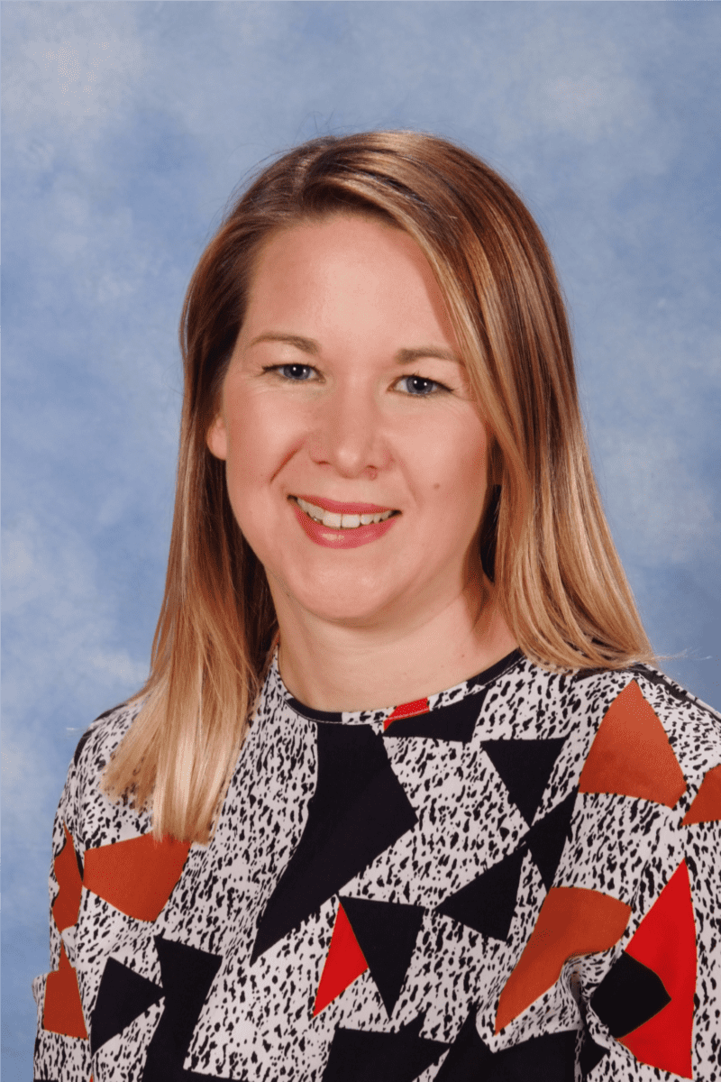
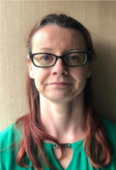
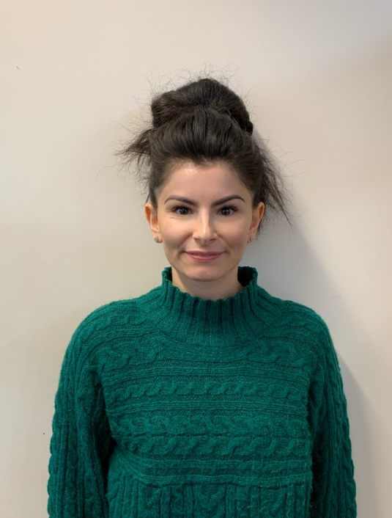
Welcome to EYFS at The Merton Primary School
Mrs Edwards (Teacher)
Miss O’Callaghan (Teacher)
Miss De Blasio (Teacher)
Notes:
Introduce self and other teachers.
Explain about the open plan nature of the base (Carpet Areas and focused teaching) and that all children will have involvement with all of the staff.

Slide 4
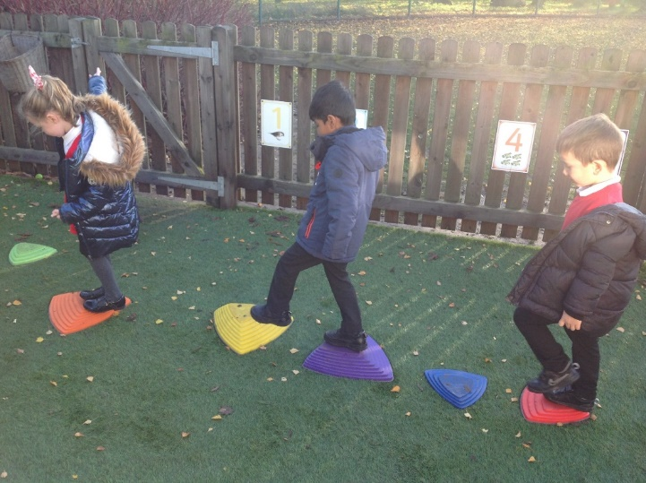
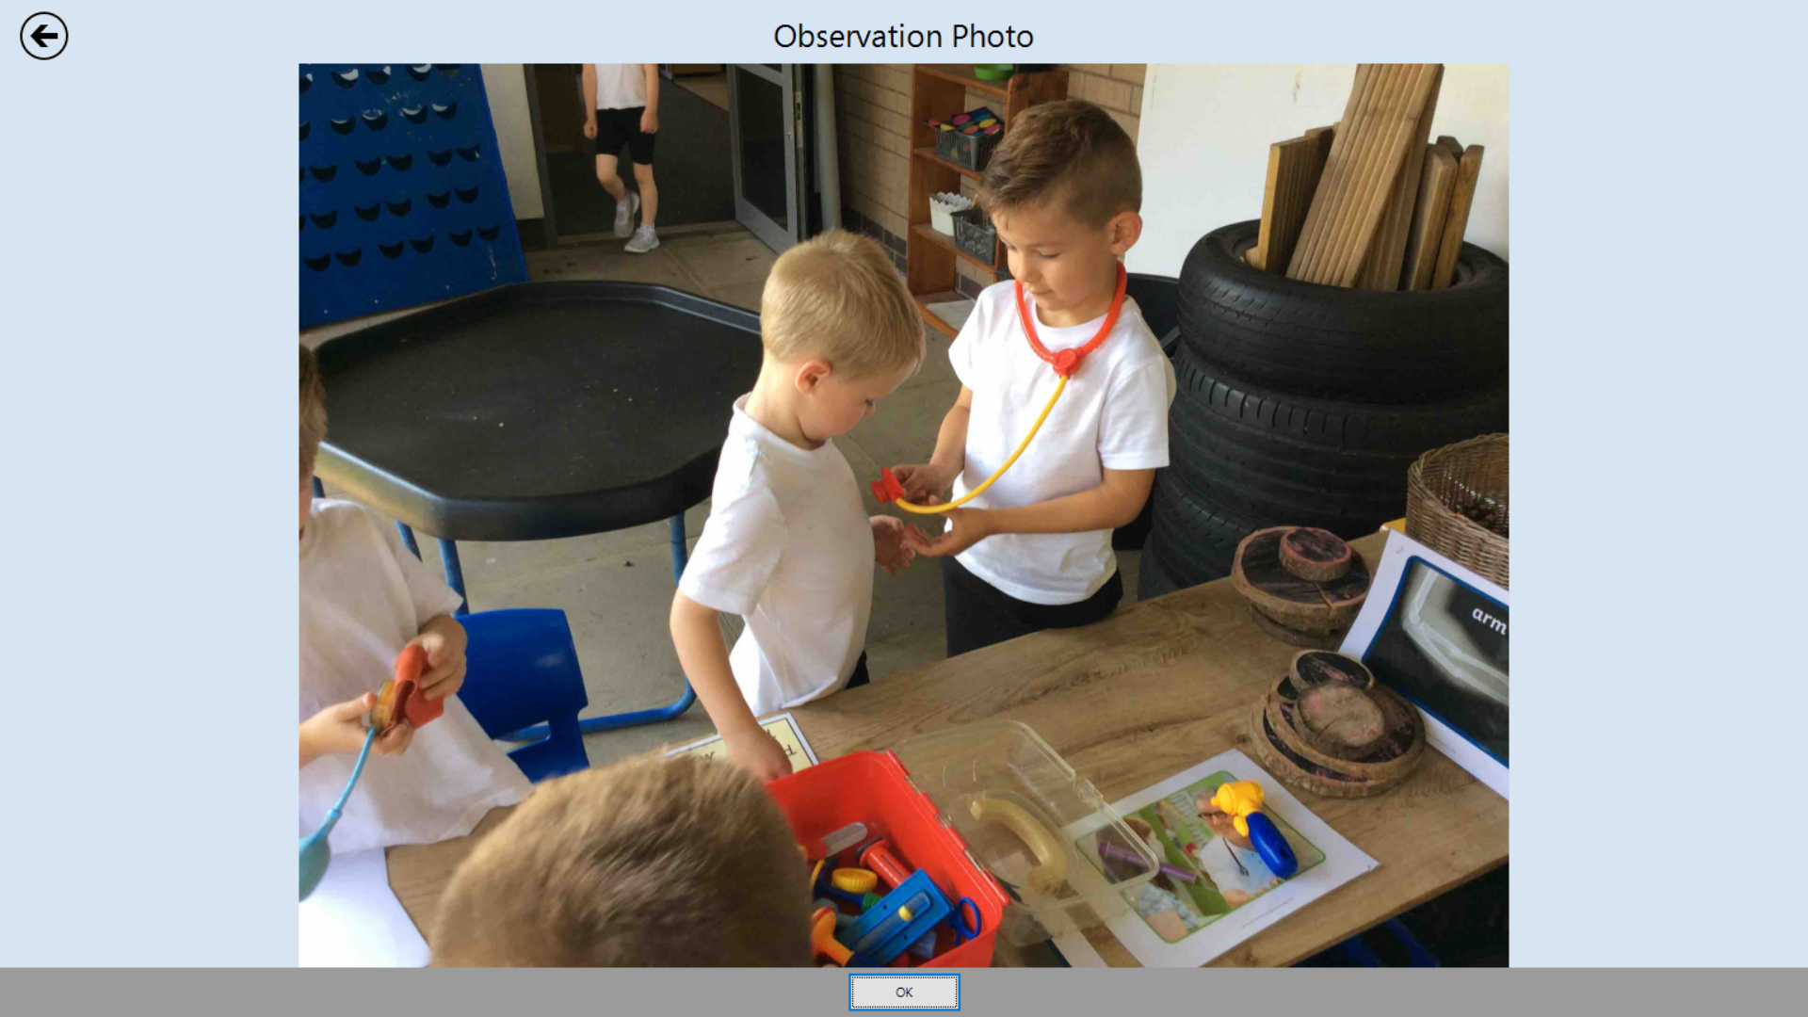
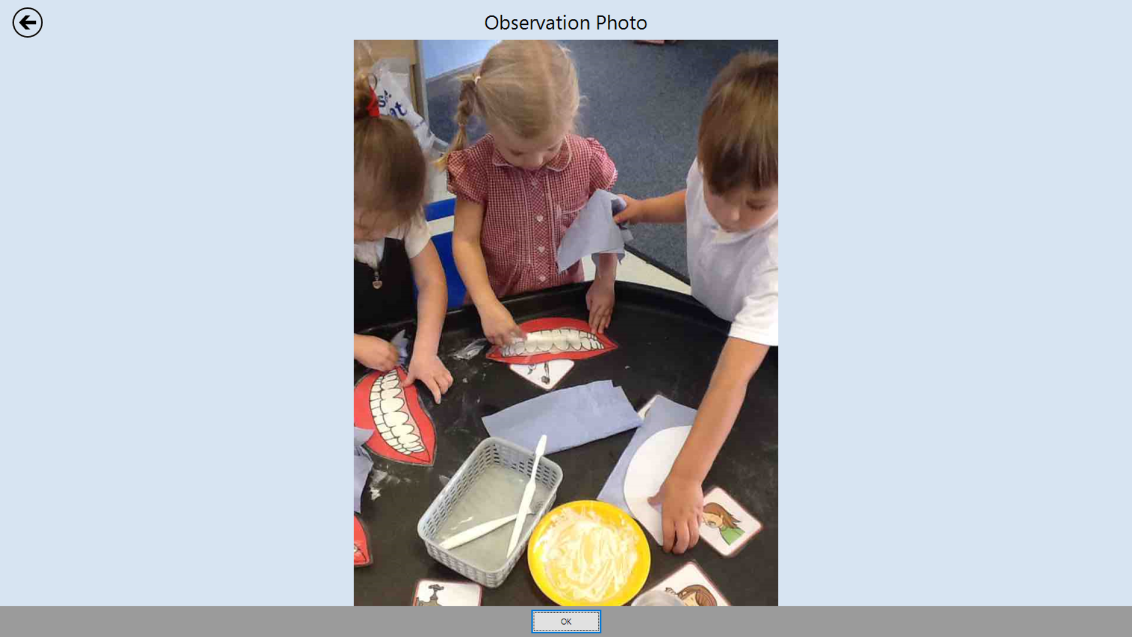
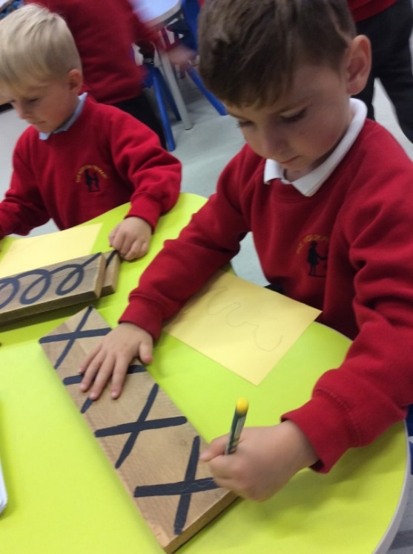
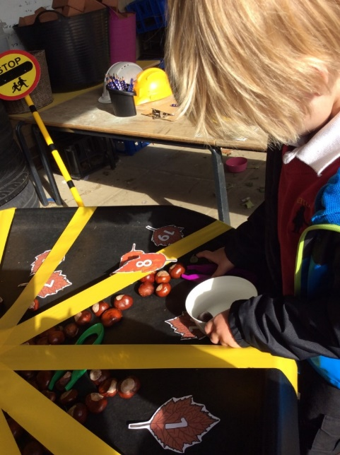
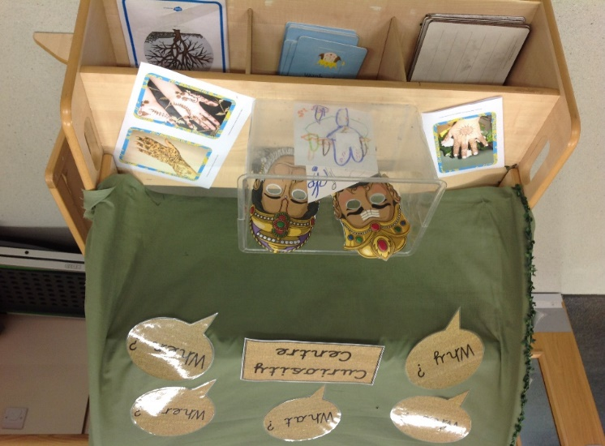
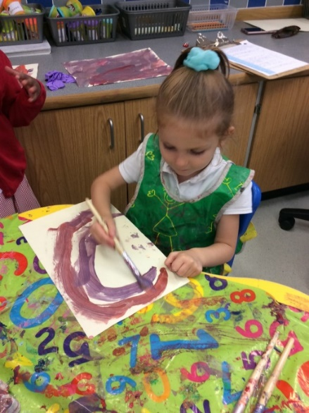
What Early Years looks like at The Merton
Physical Development
Personal, Social and Emotional Development
Understanding the World
Literacy
Mathematics
Communication and Language
Expressive Arts and Design
Notes:
The Early Years Foundation Stage is the period of education from 0-5 years or to the the end of the Reception year at school. All children who attended a pre-school setting will have been working under the EYFS curriculum. We will continue to build upon this at school.
There are 7 areas of learning we cover across the year. Here at The Merton we ensure a rich and balanced curriculum in which children will have adult led, whole class teaching and independent learning choices. Our teaching is adapted according to your child’s learning journey and it is our belief that children learn through quality experiences, play and active learning. It is a continuum of learning from play based through to year 1 ready.

Slide 5
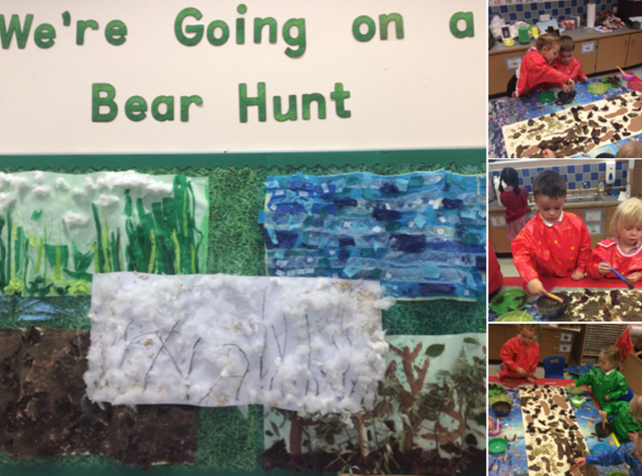
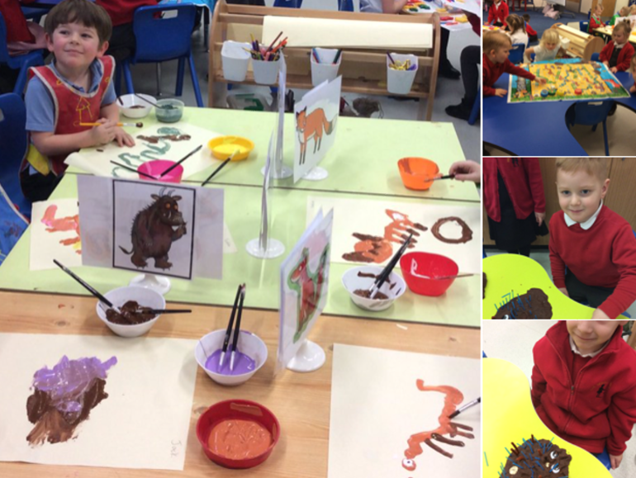
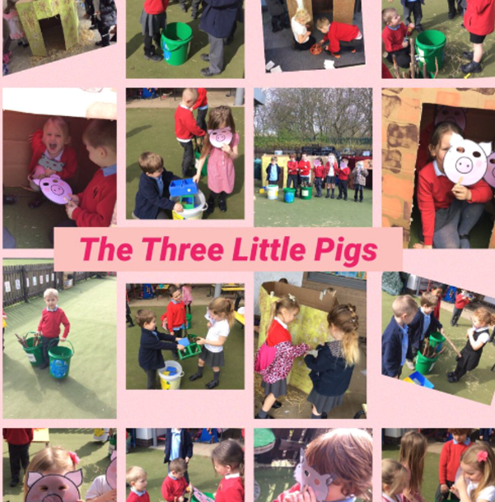
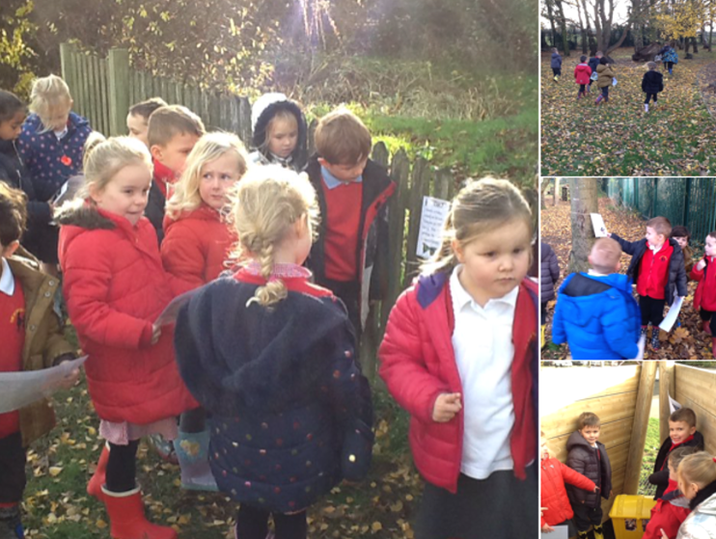
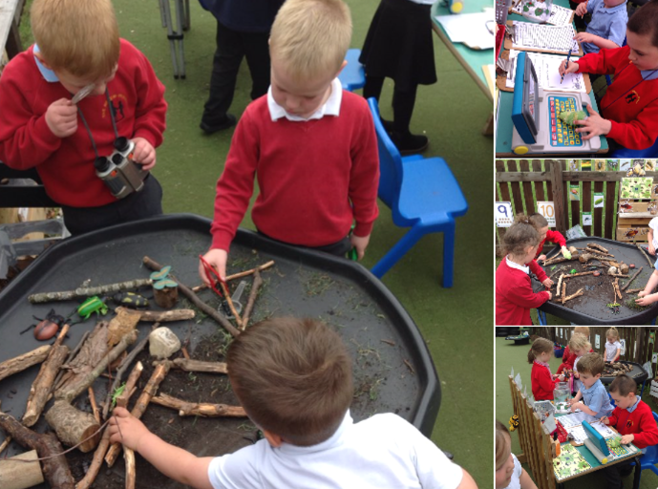
We approach your child’s learning through a variety of topics. Here are some of our favourite topics we’ve covered in the past.
Julia Donaldson
Down on the Farm
We’re Going on a Bear Hunt
If You Go Down to the Woods Today
Down at the Bottom of the Garden

Slide 6
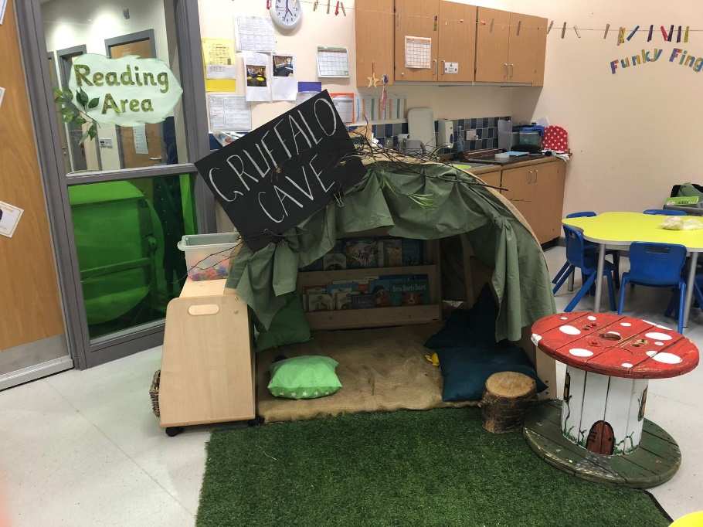
The start of the NEW school year
The children will have a staggered induction. This is a successful way for the children to get to know their new environment, school routines, staff and new friends.
It also allows us to get to know the children and parents better and ensure the transition is as smooth as possible.
Notes:
Whilst we have normally welcomed the children a class at a time into the school in the summer term – you’ll appreciate that Covid hasn’t allowed this as the children are coming from so many different settings.
Therefore, for the second year running the children will spend time in the Early Years base as a class of 30 at the beginning of the school year.
We are all really approachable staff so at any point please come and talk with us whether if be about your child or you have a question about school.

Slide 7
Specific dates are in your packs.
Your child will have 6 half day sessions of increasing lengths, one of which will include lunch.
By the seventh day, both classes will be in full time.
First two weeks
Notes:
Talk about if their child gets upset. Not to worry and to let us take control of the situation as hard as it may be.

Slide 8
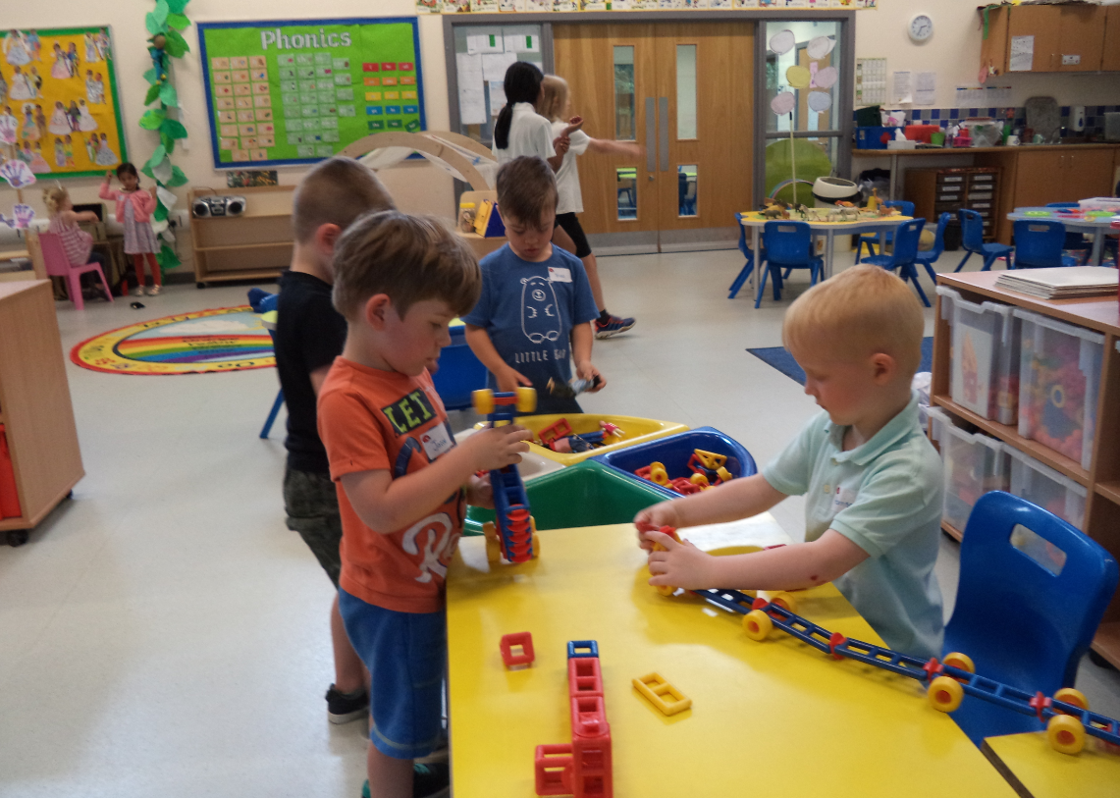
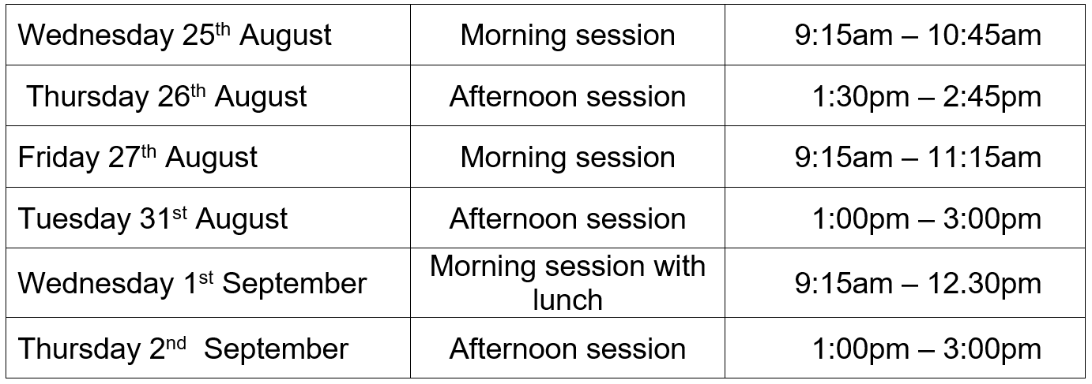
Transition sessions
Notes:
In the transition sessions all members of the Early Years Team will be on hand to support your children to settle into their new surroundings.

Slide 9
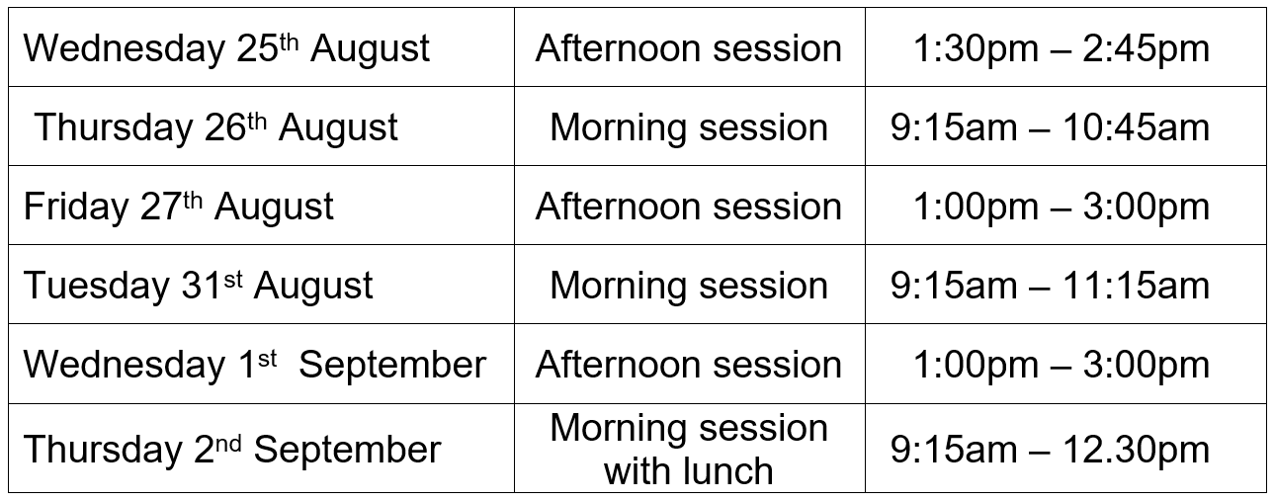
Transition sessions
Notes:
Confirmation will be send out

Slide 10
8.45 – 8.50 Doors open. Morning activity on carpet
Morning Maths/literacy input
Focused activity/ Learning Around the Room/challenge
Morning break time, milk and fruit snack
Phonics
11.55 – 1.00 Lunch time
Afternoon Learning Around the Room (1:1 reading/PSHE/UTW/Creative)
Afternoon break and fruit snack
Story time/singing
A day in the life of a Buzzy Bee and Ladybird
Notes:
Arrangements for collection and pick up will be communicated before the start of term.
Children hang coats up, find book bag boxes, come to registration carpet and join in with morning thinking.
Morning discussion using a pictorial timetable and register. Its really important the children are on time as it sets the scene for the day and the children will be missing vital learning from the onset.

Slide 11

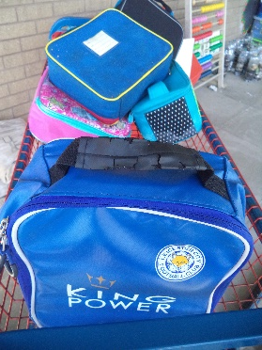
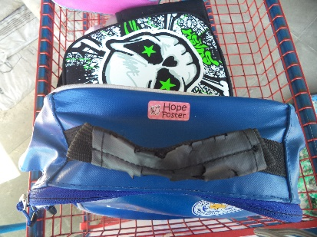
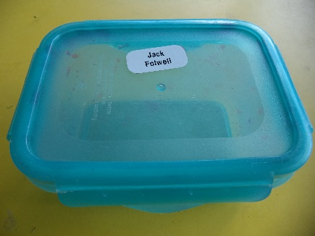
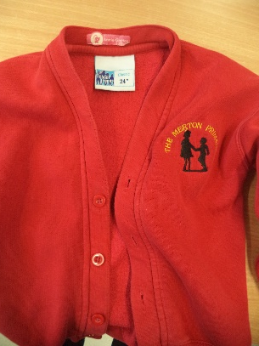
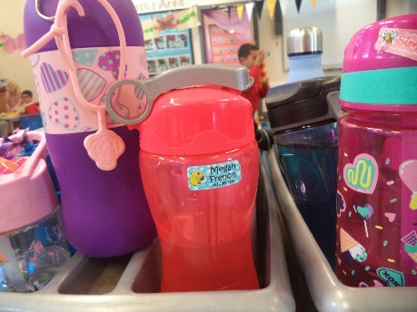
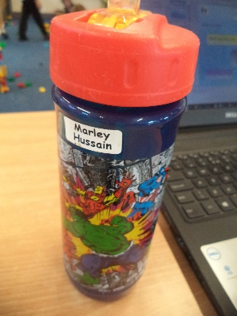
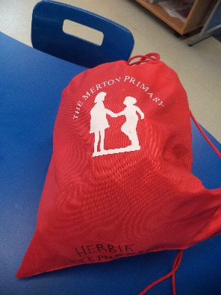
What to bring:
A named lunch box if they are not having a hot dinner
Fruit for morning snack in a named box/pot.
Book bag every day
All clothing named
A named water bottle
P.E bag – to be left on their peg
Notes:
Book Bags: will need to be brought into school each day and checked at the end of everyday for letters. Once the children have begun our phonics programme- reading books, phonics packs and a reading diary will be given to each child.
Packed Lunch bags: named and placed on the class lunch trolley.
Fruit snack: named and placed in the class snack box every morning. Once piece of healthy snack.
Clothing: clearly named.
Water bottle: the children are encouraged to drink water throughout the day. Therefore its important their bottles are brought to school each day and are clearly labelled.
PE BAG????
Free school meals – child just needs to know what they are having in the morning… to support your child with having a hot dinner at school we would suggest talking through the menu choice with your child. At the beginning of term EYFS staff will be on hand to support the children in their new environment. Once they are more familiar and become settled we’ll reduce the time we spend in the dinner hall with them.

Slide 12

Other information:
Milk
Whole School Newsletters
Notes:
PE BAG????
Free school meals – child just needs to know what they are having in the morning…
Milk – each child is entitled to free milk up until their 5th birthday after this there is a charge. If you wish for your child to receive milk at school please complete the online form, this information is in your pack. (COOL MILK)
Whole School Newsletters – this will keep you informed of what the children have been up to each week?

Slide 13
How can you help to get your child ready for school?
Talk with your child in a positive and cheerful way about starting school
Encourage your child to get dressed independently to prepare for PE
Teach them to take care of their things
Teach them to go to the toilet independently and know to wash their hands
Recognise their name
Practise counting at any time – climbing the stairs, shopping etc.
Notes:
A letter will be in the pack about activities to do at home over the summer…
We’ll upload suggestions onto the website under the Early years tab ( help early writing at home)

Slide 14

Thank you
We look forward to a happy partnership in your child’s first year at school and beyond.
Please follow us on Twitter to keep up to date with your child’s learning journey.
You will be receiving a pack with more information.
EYFS@merton.bepschools.org
Notes:
More info – uniform, breakfast and afterschool club, transition timetable
Email address

